Slide 1

Looping
Statement while, while bersarangan, do while
Chapter 4
Teknik Pemprograman
Syaeful Anas Aklani, M.Kom

Slide 2
Looping
A loop in a programming language functions to tell the computer to do something repeatedly. There are two types of loops in the Python programming language, namely loops with for and while.
The for loop is called a counted loop, while the while loop is called an uncounted loop. The difference is that the for loop is usually used to repeat code that is already known to have many repetitions. While while is for a loop that has conditions and is not certain how many repetitions it will have.

Slide 3
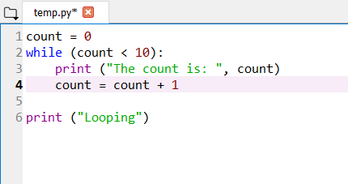
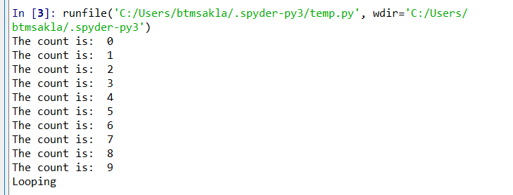
While Loop
The While Loop repetition in the Python programming language executes statements many times as long as the condition evaluates to True.
Below is an example of using a While Loop repetition.

Slide 4
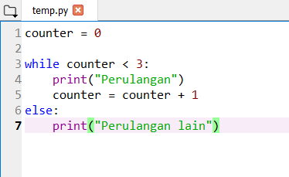
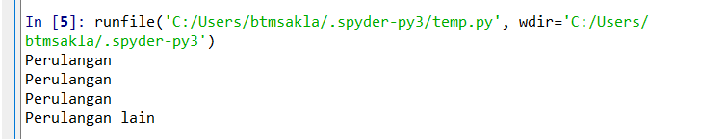
While Loop

Slide 5
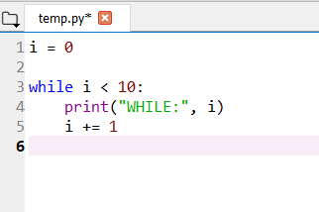
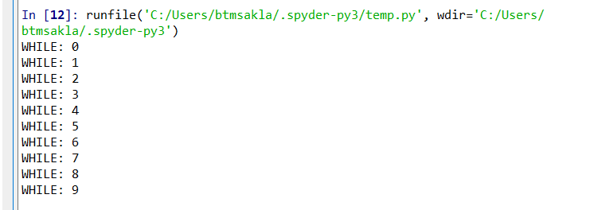
While Loop

Slide 6
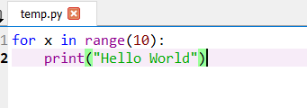
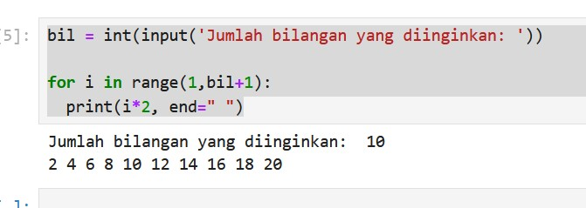
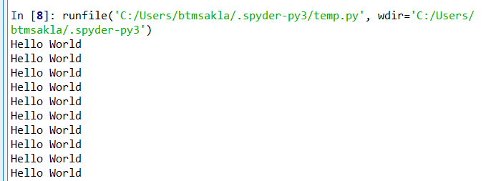
For Loop
The for loop in Python has the ability to iterate over items of any sequence, such as lists or strings.
Below is an example of using a For Loop repetition.

Slide 7
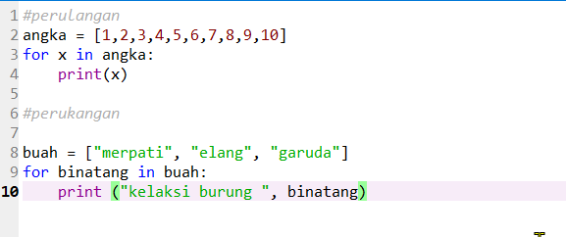
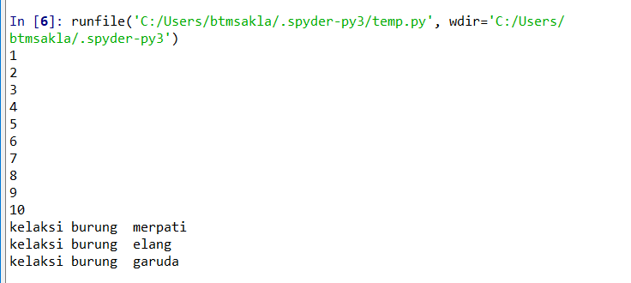
For Loop

Slide 8
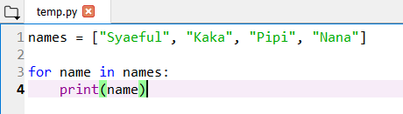
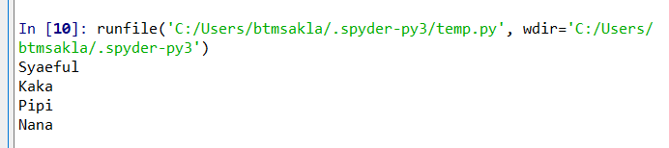
For Loop

Slide 9
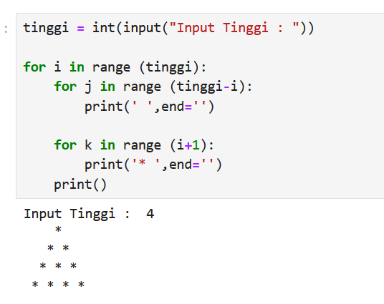
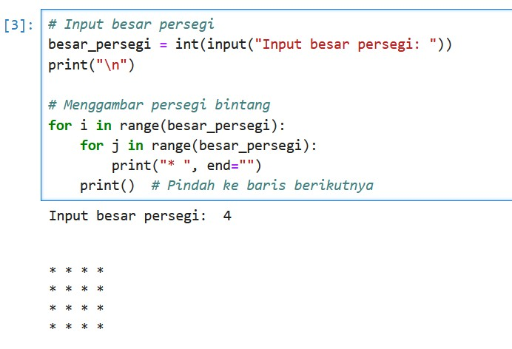
For Loop

Slide 10
Latihan
Buatlah sebuah kode program, untuk mencetak Nilai bilangan ganjil < 7;
Buatlah sebuah kode program untuk mencetak Deret berikut 1+2+3+4+..., dengan syarat jumlah Nilai total < 40; (1+2+3+4…..+39)

Slide 11
Buatlah program utk menghitung keuntungan berikut ini, jika budi belanja di toko alfa lebih dari 300 maka akan mendapat diskon 15 % dan jika belanja di bawah 300 tidak mendapat diskon
Buatlah program utk menampikan seperti di bawah ini :
Aku
Aku Mahasiswa Aku Mahasiswa UIB

